Slide 1




Accelerating Application Development with Objects
Eric Falsken
Roman Stoffel
German Viscuso
Notes:
We are db4o
We will do this quickly, you can download everything at the end.

Slide 2
Agenda
Referential Identity
Useful Application Patterns
NerdDinner
ODBMS Implementations
Useful db4o Details
Notes:
Introduce to NerdDinner application
And object database implementations of the NerdDinner Model

Slide 3
Referential Identity

Slide 4

Referential Identity
Many O-R Mappers and ODBMS use referential identity to track object updates.
Object reference in memory IS the unique ID of your data model object.
NOT the ID property you may/not add.
Watch out in multi-transactional systems and where serialization might be involved.
Notes:
Only true when .Equals has been overridden. Test equivalency.
Watch out for remote services (disconnected or serialized) objects.

Slide 5
Useful Application Patterns

Slide 6
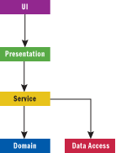
Multi-Tiered
Row-Based Results
ADO.NET DataSet
JDBC ResultSet
n-Tier
Manual Binding
Object-to-UI mapping
Assisted Binding

Slide 7
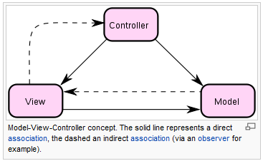
Model-View-Controller (MVC)
Decouple Models and Views
Decrease complexity
Increase flexibility.
In practice, Views and Controllers are quite closely associated
Controller and View are dependent on the Model
Difficult to test
Difficult to reuse
Notes:
1979, Xerox PARC, Smalltalk Group
Main goal is to decouple the model from the view

Slide 8
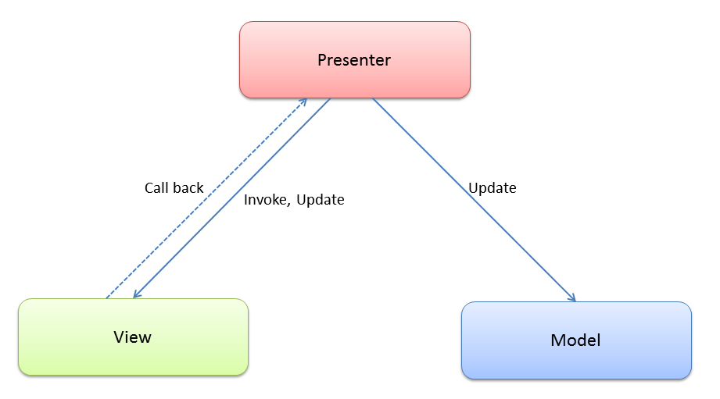
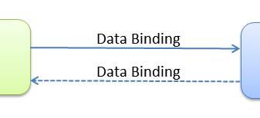
Model-View-Presenter (MVP)
View has no dependency on the Model.
Tightly bound to the Presenter
Presenter orchestrates the view
Not easily reusable
Notes:
View has no dependency on the model.
View is orchestrated by the presenter.

Slide 9
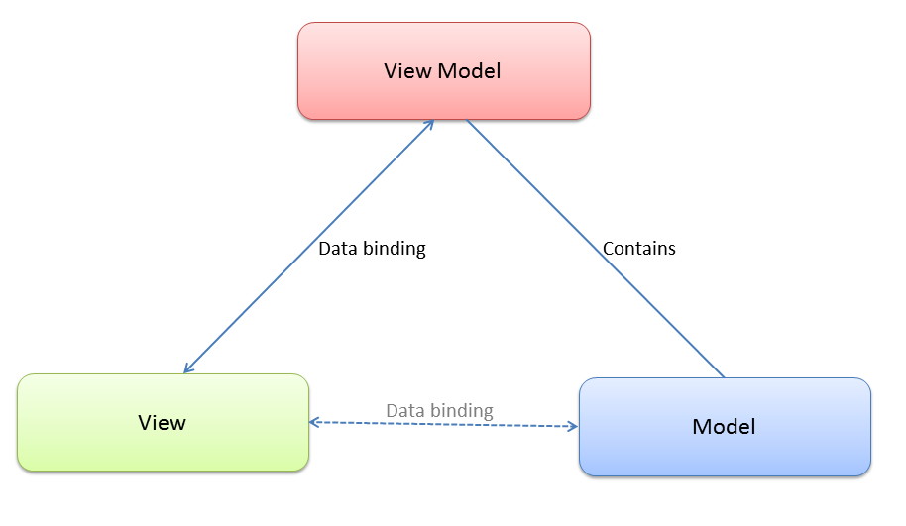
Model-View-ViewModel (MVVM)
ViewModel – Model of the View
Contracted working set
UI hints, helpers & interfaces
Syncs back to the Model
Notes:
Created by Martin Fowler, Microsoft, July 2004 as “Presentation Model”.
ViewModel UI extensions like INotifyPropertyChanged
For simple UI applications MVVM is too much overhead
Code duplication between Model and ViewModel.

Slide 10

NerdDinner

Slide 11
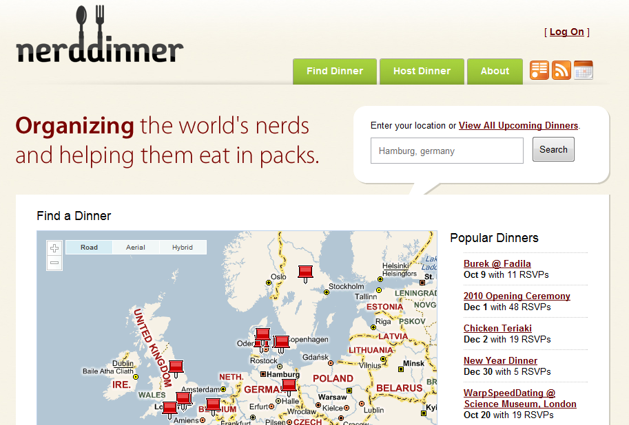
Notes:
Created by Scott Hanselman and Scott Guthrie in early 2009.

Slide 12

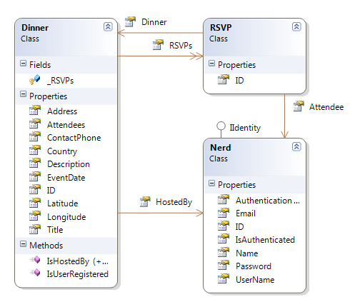
NerdDinner Model

Slide 13
NerdDinner ODBMS Implementations

Slide 14

Android
What is it?
Java-based open-source mobile OS.
Benefits
Direct UI Binding for Collections
Event-driven UI architecture
Drawbacks
No automated object binding for non-list controls
Shortcuts
Custom Adapters for Model-to-UI binding
ListAdapter, ArrayAdapter
Challenges
No framework support for advanced UI patterns.
Poor UI designer often forces editing XML by hand.
Notes:
UI-to-Object mapping by hand

Slide 15

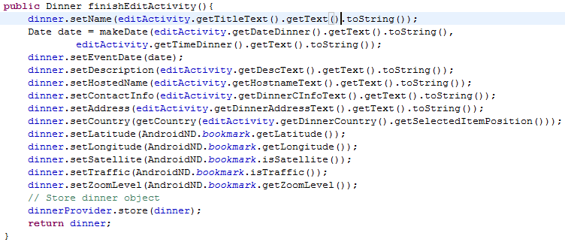
Android
A Custom adapter to bind the View data
But requires a lot of manual binding
Notes:
No help for objects

Slide 16
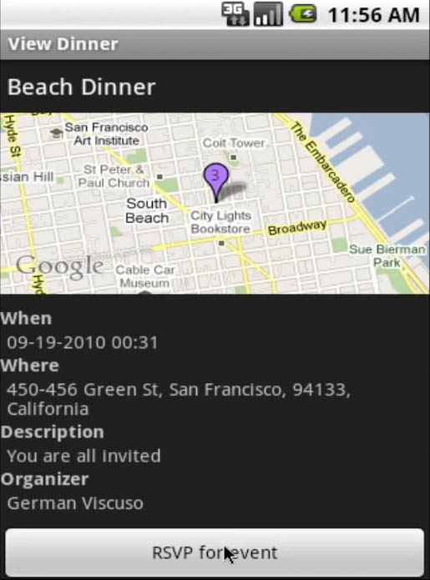
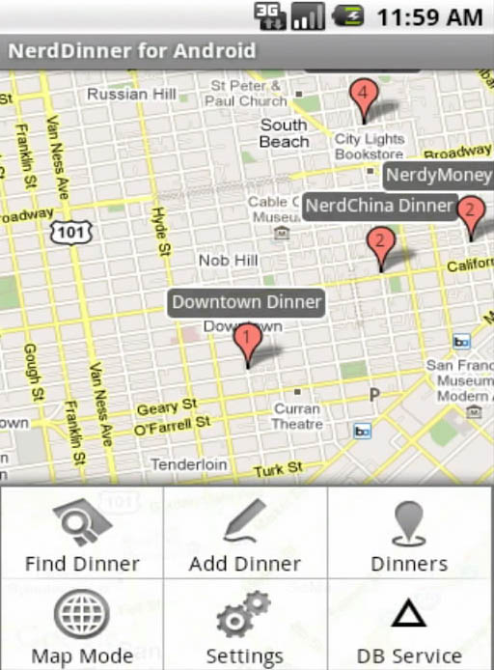
Android
Notes:
But it doesn’t stop you from creating beautiful, easy-to-use applications.

Slide 17

Spring Web Flow
What is it?
Web Application Framework based on Spring
Stateless request/response framework
Benefits
Designed to work with POJOs
Lightweight Deployment
Drawbacks
Breaks referential identity, doesn’t reuse object instances, stateless
Designed to work with Hibernate
Shortcuts
Use Spring BeanUtils or Dozer to bind stored instances
Metadata class annotations for input validation
Challenges
Without the above, Spring gives back objects, but no binding
Breaks referential identity. (Disconnected Objects)

Slide 18

Spring Web Flow
Controller receives a request for the page.
Retrieve Model from the Database.
Use a custom ModelMapper to map the View-Model.
Return JSON-encoded View-Model to the user.
Notes:
Spring calls this method when the user requests dinner details.

Slide 19
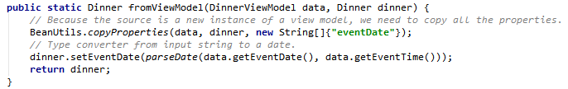
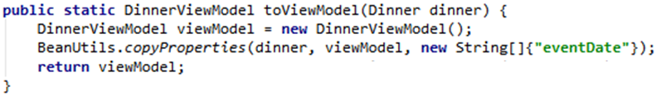
Spring Web Flow
Custom Mapper to convert between Model and ViewModel

Slide 20

Spring Web Flow
Uses modern AJAX UI library (ExtJS) to render UI and handle Request/Response UI Mapping to View-Model

Slide 21
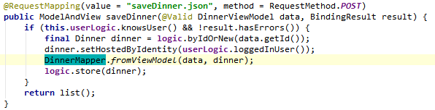
Spring Web Flow
Controller receives a View-Model update from the page.
Receives JSON-encoded View-Model.
The View-Model validates itself. (hibernate-validator)
Get the current Model instance from the Database.
Updates the Model instance with the ModelMapper.
Stores the changes.
Notes:
When the user submits his changes, Spring automatically passes us a new POJO instance of the updated Dinner
Which we can map to the stored instance using similar code.

Slide 22
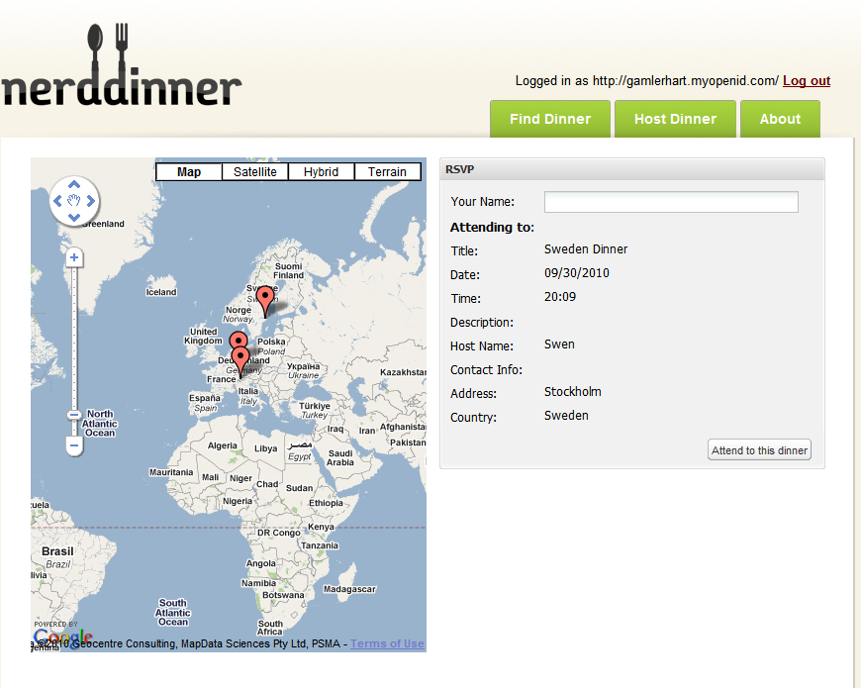
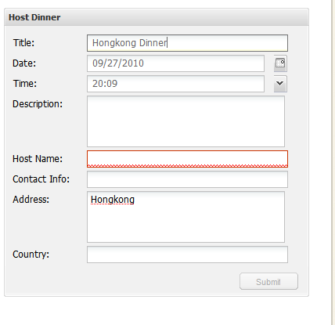
Spring Web Flow

Slide 23

Swing
What is it?
Java Desktop Application Framework
Benefits
Cross-Platform UI Implementation
Write-Once, Run Anywhere, 100% Java, No Dependencies
Drawbacks
Rendered in Java, not a “real [OS] application”.
Shortcuts
BeansBinding: Utility Library
SwingX: Intelligent UI Components
Challenges
BeansBinding is dynamically typed, string-based, fails silently
Swing without a binding library requires a lot of extra work.

Slide 24
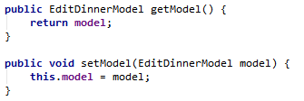
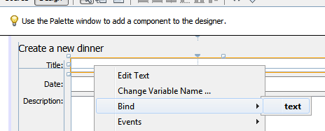
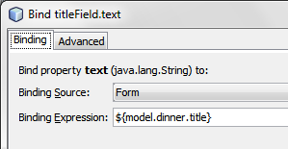
Swing
Binding a form with the NetBeans form designer:
Create a get/set method to
handle the ViewModel.
Place a control on the form, choose Bind from the context menu.
The Expression should start with the get/set method name from step 1.
Notes:
You can use NetBeans UI Deisgner to help set up your binding.

Slide 25
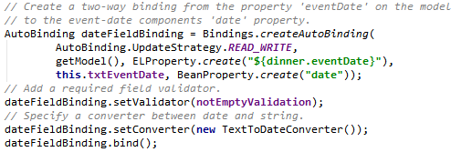
Swing
Manually setting up binding in the form code:
Normally automatically generated by the form designer.
Notes:
Or manually bind POJOs to your UI fields.

Slide 26

ASP.NET WebForms
What is it?
Microsoft .NET web application framework
Benefits
Component oriented
Virtually stateful
Drawbacks
State is sometimes serialized, complicated, bloated
Shortcuts
ObjectDataSource
LinqDataSource
Challenges
The (lack) of real page state cause disconnected objects.

Slide 27
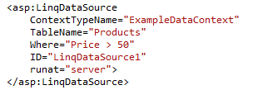
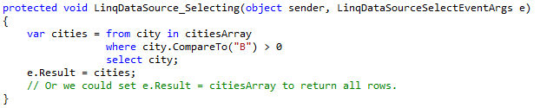
ASP.NET WebForms
Automatically create and retrieve data from a DataContext
Manually select and return data to the LinqDataSource

Slide 28
ASP.NET MVC
What is it?
Stateless web application framework for Microsoft .NET
Benefits
Excellent support for objects, validation, formatting and templating
Convention patterns are easy to follow and clearly defined
Drawbacks
A lot of the framework is By Convention
Shortcuts
System.ComponentModel.DataAnnotations
customize the templated view helpers and field html helpers
model validation
ModelBinder, ValueProvider
Challenges
So much is by convention, it’s a lot to learn
Notes:
But very rewarding

Slide 29
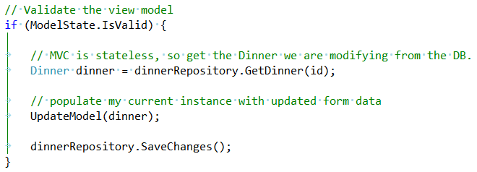
ASP.NET MVC
Updating the database with a POCO:

Slide 30
.NET WinForms, WPF and Silverlight
What is it?
Windows application frameworks for Microsoft .NET 4.0
Benefits
Easy Windows applications.
WPF allows easily designed rich client applications in XML.
Drawbacks
Single platform…Windows, unless you use Silverlight
Shortcuts
System.Windows.Data namespace
BindingOperations
Binding
IValueConverter
IDataErrorInfo
Challenges
New, much improved in .NET 4.0
Silverlight includes only a subset of Binding and Templating abilities of WPF.
Notes:
Much more mature compared to other application stacks.

Slide 31

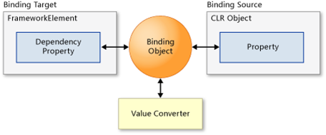
.NET WinForms, WPF and Silverlight
Assisted binding with System.Windows.Data Bindings class:

Slide 32
Useful db4o Tips

Slide 33
db4o & Transactions
Local Single Transaction Context
Db4oEmbedded.OpenFile()
Best for Single-User applications like Android, Desktop
Local Multiple Transaction Contexts
(Does not require the ClientServer library)
Db4oEmbedded.OpenFile()
anyObjectContainer.OpenSession()
Best used for single-server, multi-user applications
Networked
(Requires db4o C/S library)
Db4oClientServer.OpenServer()
Db4oClientServer.OpenClient()
Notes:
Similar to SQLite or libmysqld

Slide 34
db4o & Identity
In platforms with disconnected objects, add an ID field to your model classes for easy reference.
ASP.NET MVC
WebFlow
When updating stored instances, retrieve the current object, update its values, store it back again.
Use a new ObjectContainer for each request, but reuse it for as long as possible. Avoid re-opening another ObjectContainer unnecessarily.
Don’t leave your ObjectContainer client sessions to be GC’d. Close them!

Slide 35
db4o Server Implementations
Download our sample servers.
Add a reference to your model & NQ classes.
Compile and deploy.
Db4o requires your class model loaded locally for many operations.
e.g. un-optimized queries (complex query edge cases)
.NET Native for Windows
Java Native
Windows, Linux, Mac OS X

Slide 36
Download Everything: www.ObjectDinner.com

